Slide 1
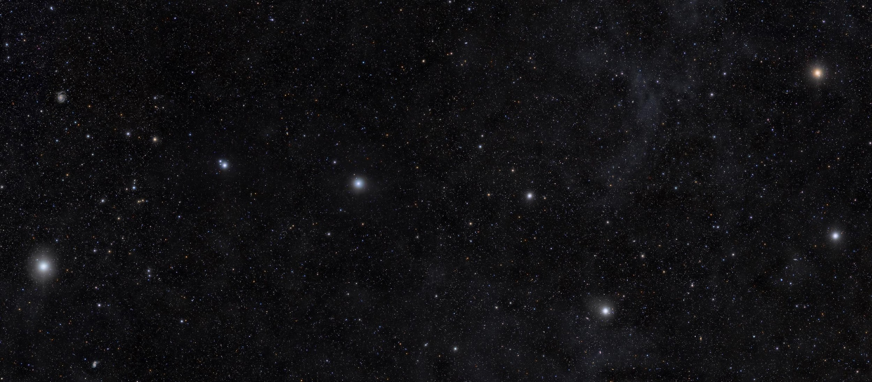



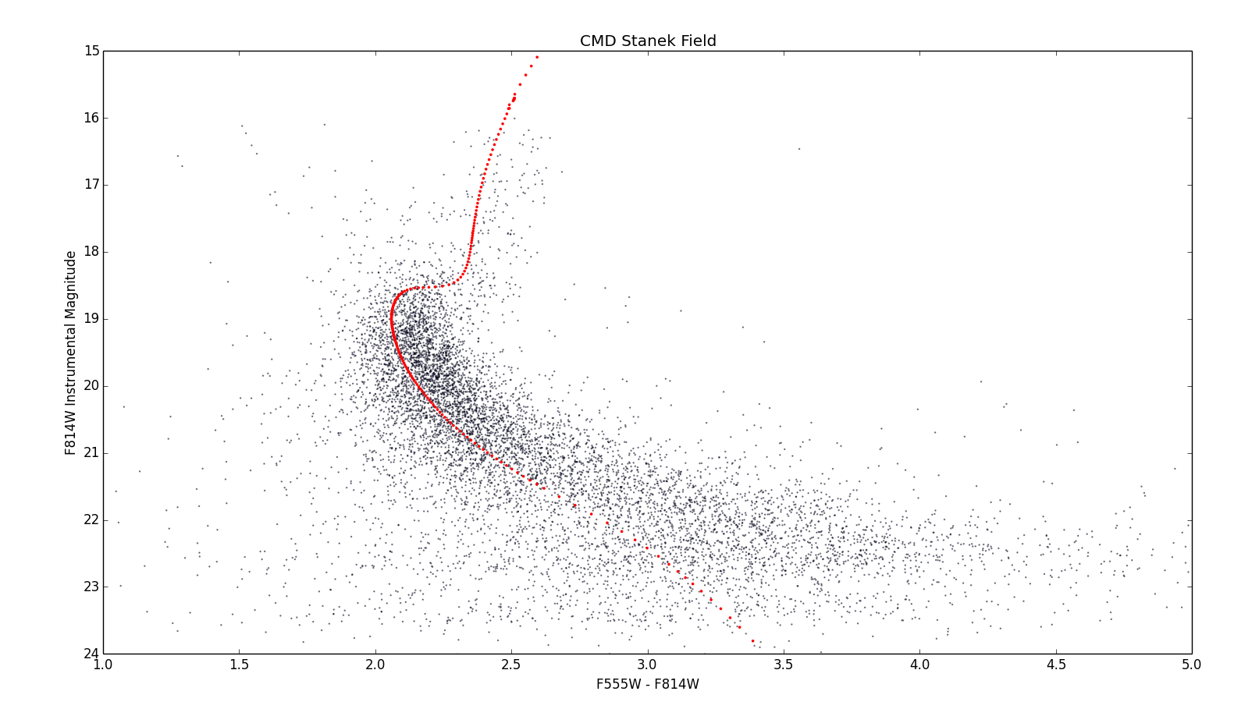
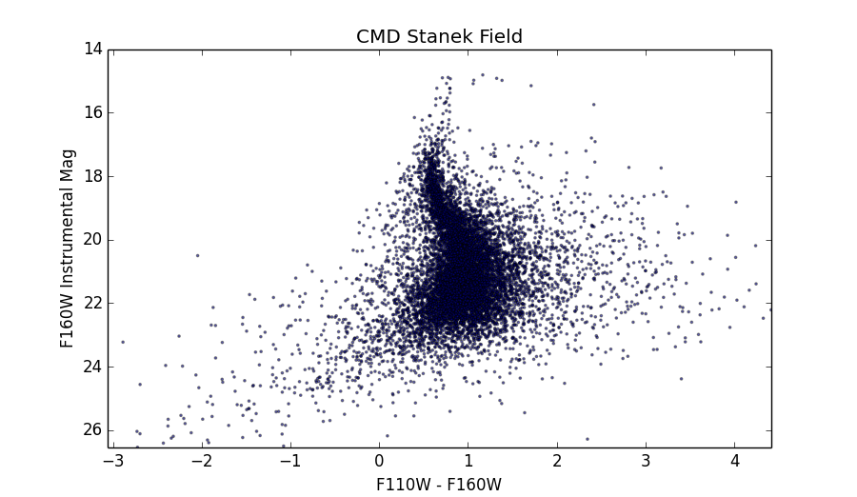
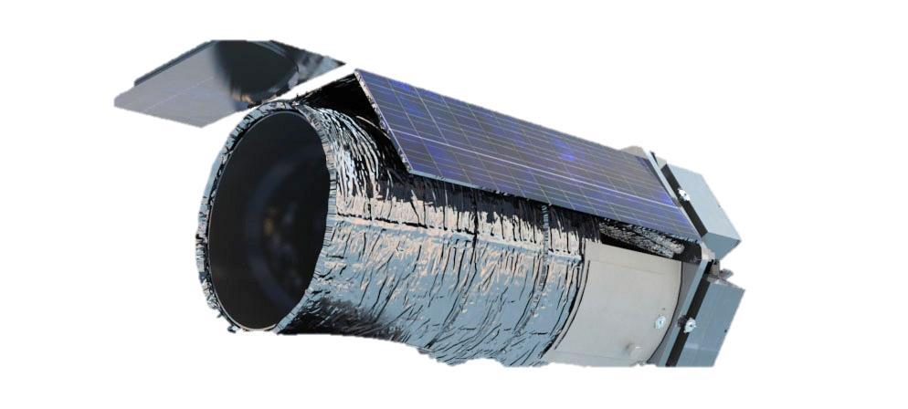
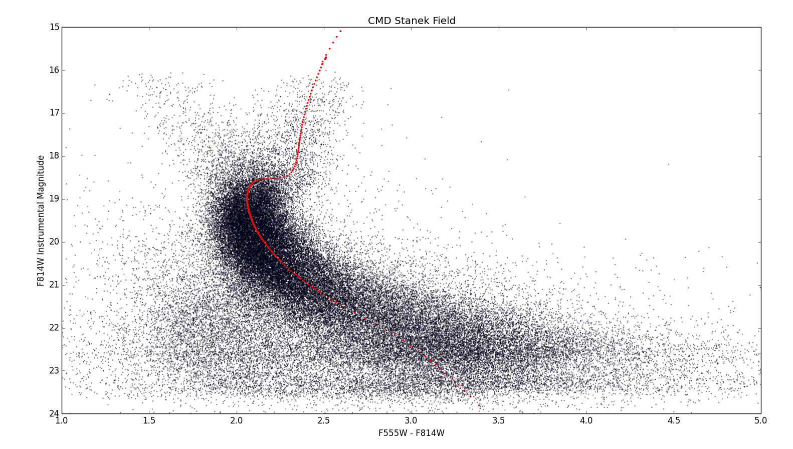
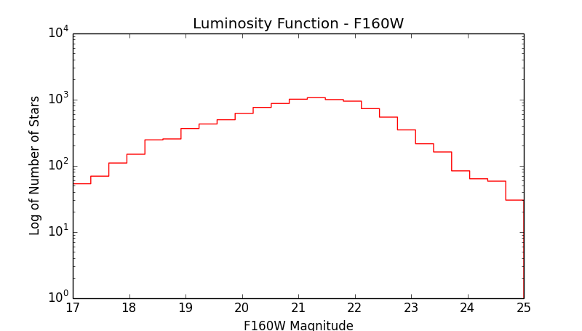
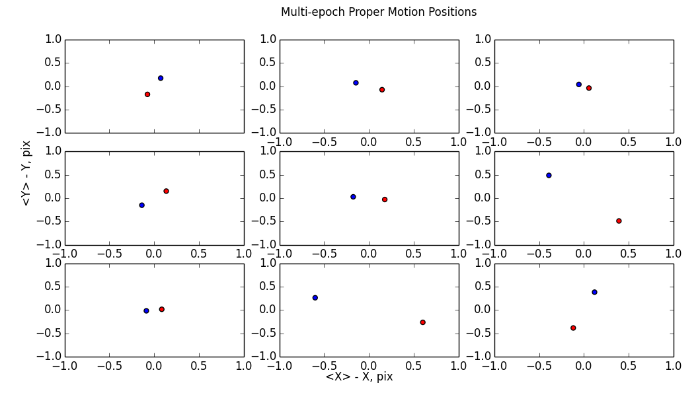
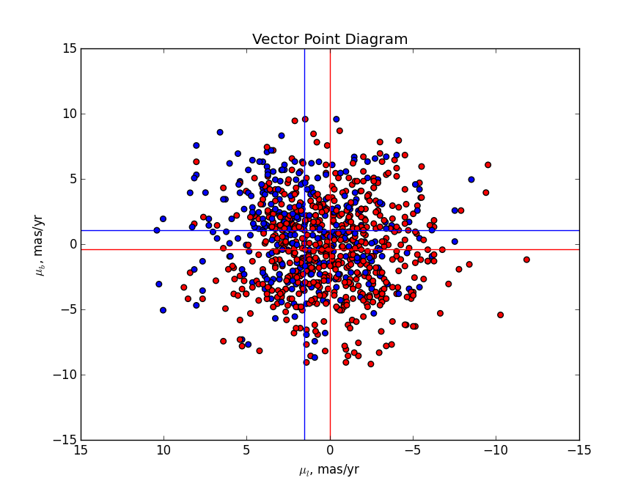
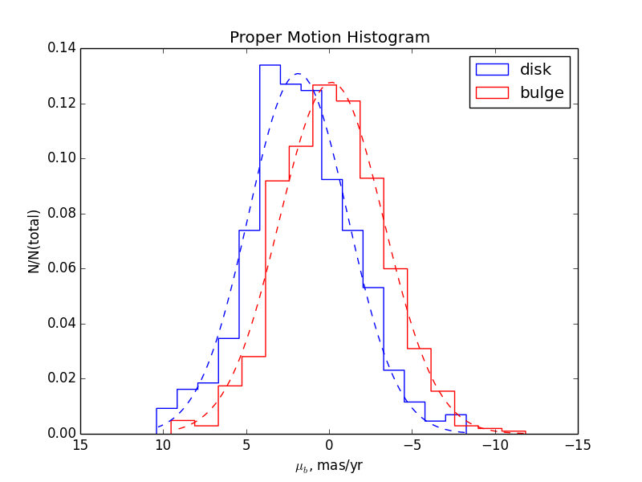
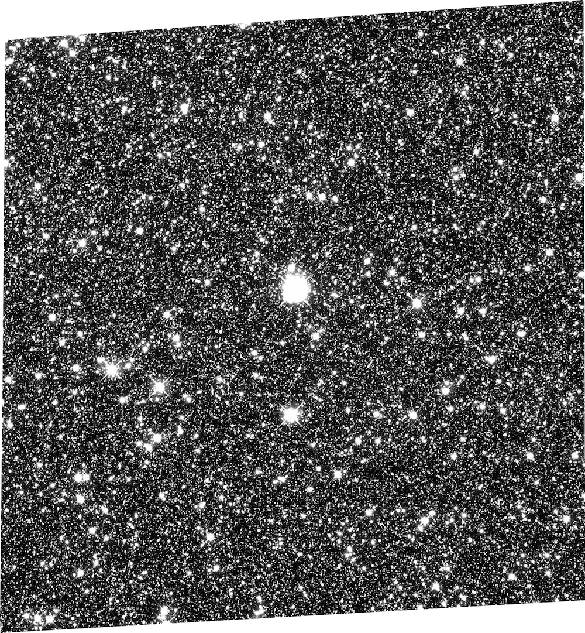
PROPER MOTION MEASUREMENTS IN THE GALACTIC BULGE AND DISK WITH
IMPLICATIONS FOR SOURCE STAR CHARACTERIZATION DURING THE WFIRST MISSION
Science Poster
Sean Terry¹, Ishaan Gandhi², David Bennett³, Richard Barry³ (code 667)
¹The Catholic University of America
²Thomas Jefferson High School for Science and Technology
³Laboratory for Exoplanets and Stellar Astrophysics
Motivation
The Wide-Field Infrared Survey Telescope (WFIRST) will monitor millions of stars within the galactic bulge during its microlensing mission. A degeneracy arises when considering the color of the source star in a microlensing event. If the source star is a member of the background disk population that lies on the far side of the bulge, then the observed color for that star will appear bluer than what is predicted. In order to fully characterize the source star in a microlensing event, details about the bulge and disk populations need to be examined. No substantial probe of the far side disk stars has been conducted in reference to microlensing events.
Preliminary work that involves studying deep luminosity functions and bulge/disk proper motions will help to answer questions related to source star characterization during microlensing events, leading up to the launch of the telescope in the mid-2020’s.
Abstract
We present relative stellar proper motions in the Stanek window of the galactic bulge for two epochs, 2010 and 2012. Motions for approximately 65,000 stars are observed using WFC3 on board the Hubble Space Telescope (HST). Using both kinematics and color/magnitude, we are able to extract a very clean sample of 10,000 bulge stars.
Astrometry
DOLPHOT (a high precision astrometry and photometry routine), which is configured to implement Jay Anderson’s PSF library, is used to process the WFC3 images, and catalogs of stellar position and brightness are created. After correcting for a misalignment in the images, we compile a list containing pure proper motion values between the two epochs.
.
Separating Disk and Bulge Stars
In order to create a clean luminosity function (LF) of bulge stars, contamination from disk stars must be removed. Due to large overlaps in kinematics of disk and bulge stars, separation between the populations is first achieved by considering all stars above the main sequence turn off. These stars are clearly separated on a color magnitude diagram (CMD) created from the F814W and F555W filters into an older, late-evolution bulge population, and an unevolved main sequence disk population.
Plotting the proper motions of individual stars, a vector point diagram shows a marked difference in the centroid value of the two populations corresponding to a mean bulge proper motion of (𝞵l, 𝞵b) ≅ (0 mas/yr, 0 mas/yr), and a mean disk proper motion of (𝞵l, 𝞵b) ≅(1.5 mas/yr, 1.0 mas/yr). When separating the bulge and disk populations below the main sequence turnoff, we create another vector point diagram. We take all stars with proper motion less than -2 mas/yr in both the x and y coordinate directions to be bulge stars and discard all others.
From here, a clean bulge sample is presented on our CMD. A luminosity function (LF) is then created from this dataset using only the clean sample of bulge stars (not shown).
Examining Proper Motions
Infrared Channel
Proper motion measurements followed by kinematic and color separations are repeated for IR-channel images (F110W and F160W) and deeper CMDs and LFs are created.
Discussion
High-precision proper motion measurements were carried out on stellar catalogs in multiple wavebands. The astrometry routine used has a measurement precision of 0.01. When plotting the motion of the stars above the main-sequence turnoff, two clear populations emerge. Using this separation as a catalyst, we produce a very clean CMD and luminosity function for the bulge (and background disk population) with approximately 2% contamination from foreground disk stars. Future work for this project will involve producing a clean background-disk star catalog and studying the characteristics of those objects in detail.
Acknowledgements & References
Special thanks to Richard Barry and David Bennett for their valuable contributions to our project. We also thank Jay Anderson and Andy Dolphin for their advice and recommendations for the photometry and astrometry routines.
Anderson, J., King, I.R. 2000, PASP, 112, 1360
Brown, T. 2008, HST prop, 11664, 17
Calamida, A., Sahu, K.C., et al. 2014 ApJ, 790, 164
Clarkson, W., et al. 2008, ApJ, 684, 1110
Dolphin, A.E., 2000, PASP, 112, 1383
Dotter, A., Chaboyer, B., et al. 2008, ApJS, 178 1
Gennaro, M., Brown, T., et al. 2015 ASP, 491
Kuijken, K., Rich, R.M., 2002, AJ, 124, 2054
Sahu, K., et al., 2006, Nature, 443, 534
Fig 1. Model image of WFIRST.
Fig 5.Color-magnitude diagram for F555W-F814W. Objects presented all have proper motions of less than -2 mas/yr in both galactic latitude and longitude directions.
Fig 3. Color-magnitude diagram for F555W - F814W. No proper motion cleaning has been performed at this point.
Fig 6. Multi-epoch difference in X and Y pixel position between the 2010 and 2012 datasets. Red points are 2010 and blue points are 2012.
Fig 2. Drizzled reference image from the F814W filter on WFC3. Image is from the 2012 epoch.
Fig 4. Relative proper motions of the two populations; red points are bulge, blue points are disk. Centroids of populations are given by the lines.
Fig 7. Longitudinal proper motion histogram. The mode bulge star proper motion histogram bin is approximately 0.

